Slide 1
Topic 3: Conceptualising Interaction
SECV2113 Human-Computer Interaction
Faculty of Computing
Universiti Teknologi Malaysia

Slide 2
CONCEPTUALISING INTERACTION
01
CONCEPTUAL MODELS
02
INTERFACE METAPHORS
03
INTERACTION TYPES
04

Slide 3
CONCEPTUALISING
INTERACTION

Slide 4
Conceptualising Design
Proof of concept
Conceptualise what the proposed product will do
Why the need to conceptualising design?
To scrutinise vague ideas and assumptions about the benefits of the proposed product and user experience in terms of their feasibility
How realistic is it to develop?
How desirable and useful?
Many unknowns need to be considered in the initial stages of a design project
Especially if it is a new product that is being proposed

Slide 5
Consider Design Example 1
A designer comes up with the idea of creating a mobile robot server:
help waiters in a restaurant take orders and deliver meals to customers
Why ? What problem would this address?
Putative benefits
Could help take orders and entertain customers by having a conversation with them at the table
Design concerns
How would it need to move to appear to be talking?
What would the customers think of it?
Would it always be a pleasure for them to engage with the robot, not knowing what it would say on each new visit to the restaurant?
Would it be annoying or a fad?

Slide 6
Consider Design Example 2
An automated robot server that is functional
In contrast to the idea of a waiter robot the robot server addressed a real-world problem
the cooks load up the trays on its shelves, and then sends it to a preset area of the dining room to deliver the food
the customers remove the food and drinks from the robot server
It is like a tool, there to save waiters’ time rather than replacing them

Slide 7
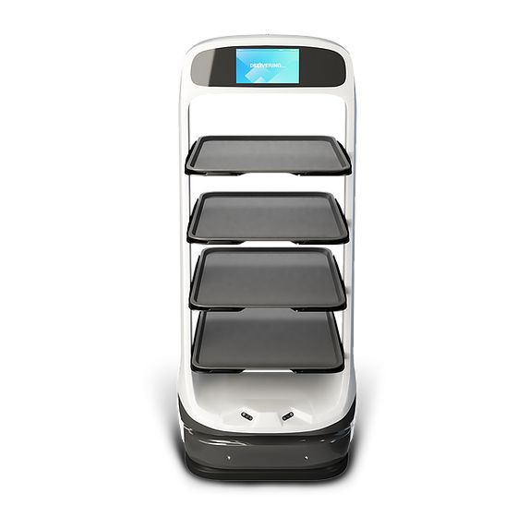
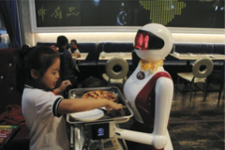
Which type of server is preferable and on what grounds?
Source: https://richtechrobotics.com/

Slide 8
Assumptions and Claims
Write down your assumptions and claims when deciding which one you prefer
Try to defend and support them by what the two different servers will provide

Slide 9
What is an Assumption?
Taking something for granted when it needs further investigation, e.g.
The robot could take orders and entertain customers by having a conversation with them
The robot could make recommendations for different customers, such as restless children or fussy eaters

Slide 10
What is a Claim?
A claim is stating something to be true when it is still open to question
It will raise revenue by attracting more people to the restaurant
It will solve the labor crisis of there being not enough human waiters
The real problem being addressed:
“It is difficult to recruit good wait staff who provide the level of customer service to which we have become accustomed.”
Notes:
Writing down your assumptions and claims and then trying to defend and support them can highlight those that are vague or wanting. In so doing, poorly constructed design ideas can be reformulated. Explicating people’s assumptions and claims about why they think something might be a good idea (or not) enables the design team as a whole to view multiple perspectives on the problem space and in so doing reveal conflicting and problematic ones.

Slide 11
Working through Assumptions
Need to work through the initial stages of a design project
Where do your ideas come from?
What sources of inspiration were used?
Is there any theory or research that can be used to inform them?
During the early ideation process
Ask questions, reconsider assumptions, and articulate concerns

Slide 12
Poor Assumptions
Those that are difficult to articulate
can highlight what ideas are vague or unrealistic
identify human activities and interactivities that are problematic
Based on this kind of conceptual analysis iteratively work out how the design ideas might be improved

Slide 13
A Framework for Analysing the Problem Space
Are there problems with an existing product or user experience? If so, what are they?
Why do you think there are problems?
How do you think your proposed design ideas might overcome these?
If you are designing for a new user experience, how do you think your proposed design ideas support, change, or extend current ways of doing things?

Slide 14

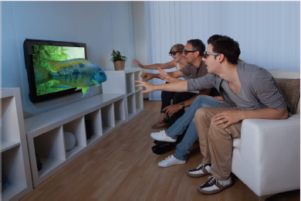
Activity
What were the assumptions and claims made about watching 3D TV?
A family watching 3D TV
Source: Andrey Popov, Shutterstock

Slide 15
Assumptions and Claims: How realistic?
There was no existing problem to overcome
What was being proposed was a new way of experiencing TV
An assumption
People would really enjoy the enhanced clarity and color detail provided by 3D
A claim
People would not mind paying a lot more for a new 3D-enabled TV screen because of the new experience

Slide 16
From Problem Space to Design Space
Having a good understanding of the problem space can help inform the design space
for example, what kind of interface, behavior, functionality to provide
Before deciding upon these, it is important to develop a conceptual model

Slide 17
Benefits of Conceptualising
Orientation
Enables design teams to ask specific questions about how the conceptual model will be understood
Open-minded
Prevents design teams from becoming narrowly focused early on
Common ground
Allows design teams to establish a set of commonly agreed terms

Slide 18
CONCEPTUAL
MODEL

Slide 19
Conceptual Model
A conceptual model is:
“…a high-level description of how a system is organised and operates” (Johnson and Henderson, 2002, p26)
It enables:
“…designers to straighten out their thinking before they start laying out their widgets” (Johnson and Henderson, 2002, p28)
Provides a working strategy and framework of general concepts and their interrelations

Slide 20
Components
Metaphors and analogies
Understand what a product is for and how to use it for an activity
Concepts that people are exposed to through the product
Task–Domain objects, their attributes, and operations (for example, saving, revisiting, organising)
Relationship and mappings between these concepts
E.g. whether one object contains one another, and, whether one can revisit through looking at a list of visited sites

Slide 21
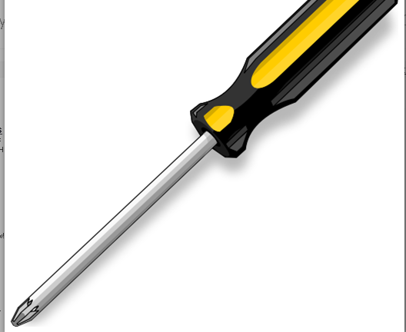
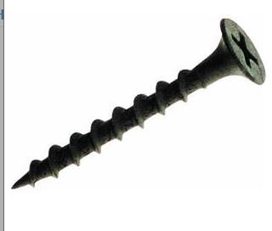
…what concepts are needed to understand how to interact with this interface..?
Mappings?
Insert screwdriver
Turning screwdriver

Slide 22
First Steps in Formulating a Conceptual Model
What will people be doing when carrying out their tasks?
How will the proposed model support these?
What kind of interface metaphor, if any, will be appropriate?
What kinds of interaction modes and styles to use?
Keep in mind when making design decisions how the user will understand the underlying conceptual model

Slide 23
Conceptual Models
Many kinds and ways of classifying them
The best conceptual models are often those that appear:
Obvious and simple
The operations they support are intuitive to use

Slide 24
INTERFACE
METAPHORS

Slide 25
Interface Metaphors
Interface designed to be similar to a physical entity but also has own properties
e.g, desktop metaphor, web portals, search engine
Can be based on activity, object, or a combination of both
Exploit user’s familiar knowledge, helping them to understand ‘the unfamiliar’
Conjures up the essence of the unfamiliar activity, enabling users to leverage this to understand more aspects of the unfamiliar functionality

Slide 26
Examples of Interface Metaphors
Conceptualising what users are doing
e.g, surfing the Web
A conceptual model instantiated at the interface
e.g., the desktop metaphor
Visualising an operation
e.g., an icon of a shopping cart into which the user places items

Slide 27
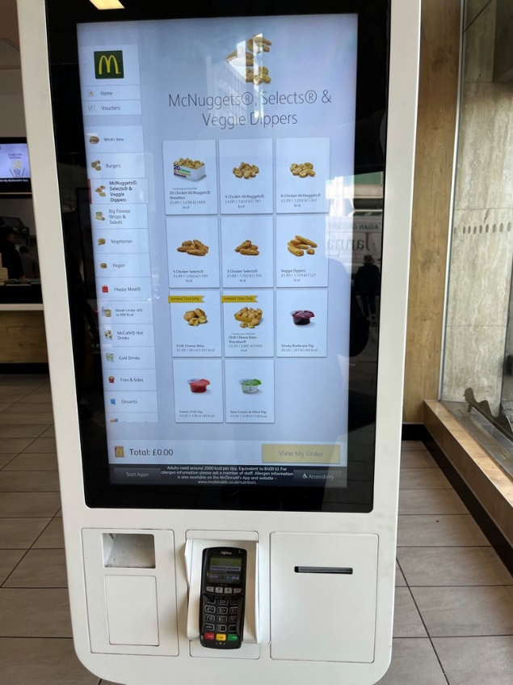
The Card Metaphor
The card is a very popular metaphor. Why?
It has familiar form factor
It can easily be flicked through, sorted, and themed
Cards have strong associations, providing an intuitive way of organising content that is “card sized”
Structures content into meaningful chunks
A fast food display

Slide 28
Benefits of Interface Metaphors
Makes learning new systems easier
Familiar artefact or action helps people understand the underlying conceptual model
Can be innovative and enable apps to be made accessible to a greater diversity of people

Slide 29
Problems with Interface Metaphors
Break conventional and cultural rules
e.g, recycle bin placed on desktop
Can constrain designers in the way that they conceptualize a problem space
Can conflict with design principles
Designers can inadvertently use bad existing designs and transfer the bad parts over
Limits designers’ imagination in coming up with new conceptual models
Often don’t scale very well, especially when trying to describe how complex systems work (Cooper, 2020)

Slide 30
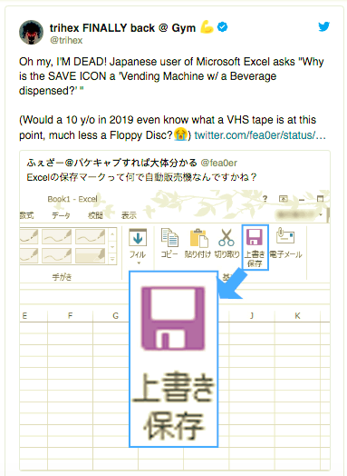
Problem with Interface Metaphor Example

Slide 31
Activity
Describe the components of the conceptual model underlying most online shopping websites, for example:
Shopping cart
Proceeding to check-out
1-click
Gift wrapping
Cash register

Slide 32
INTERACTION
TYPES

Slide 33
Interaction Types
Instructing
Issuing commands and selecting options
Conversing
Interacting with a system as if having a conversation
Manipulating
Interacting with objects in a virtual or physical space by manipulating them
Exploring
Moving through a virtual environment or a physical space
Responding
The system initiates the interaction and the person chooses whether to respond

Slide 34
1. Instructing
Where someone instruct a system and tells it what to do
e.g.Tell the time, print a file, or save a file
Very common conceptual model underlying a diversity of devices and systems
e.g. Word processors, VCRs, vending machines
The main benefit is that instructing supports quick and efficient interaction
Good for repetitive kinds of actions performed on multiple objects

Slide 35
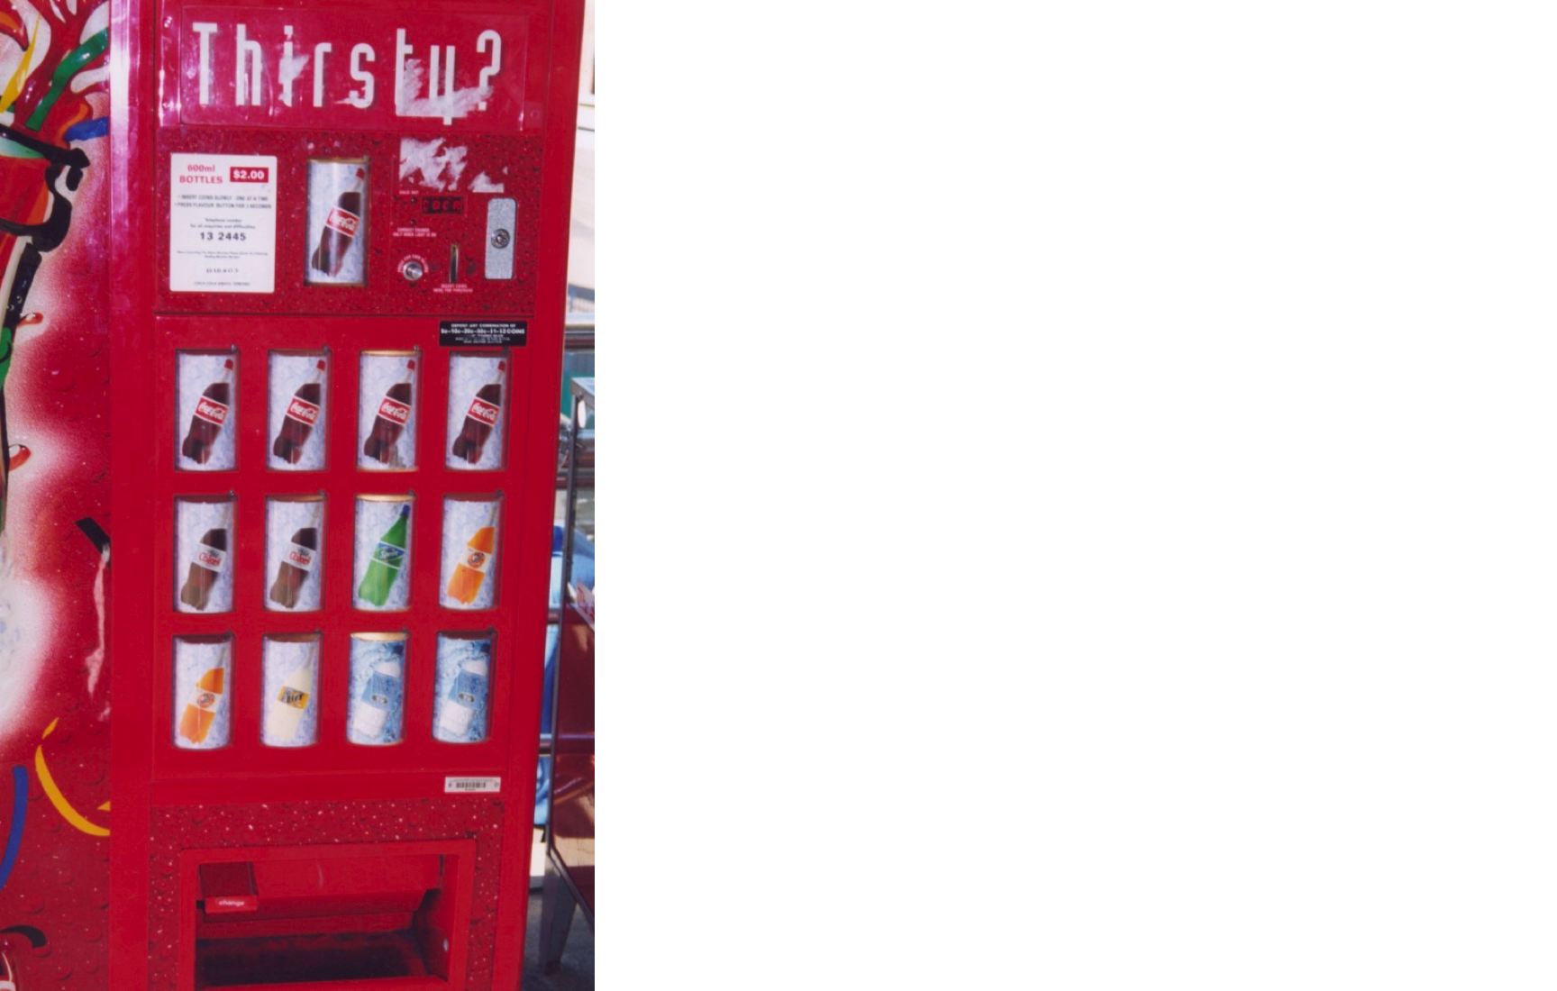
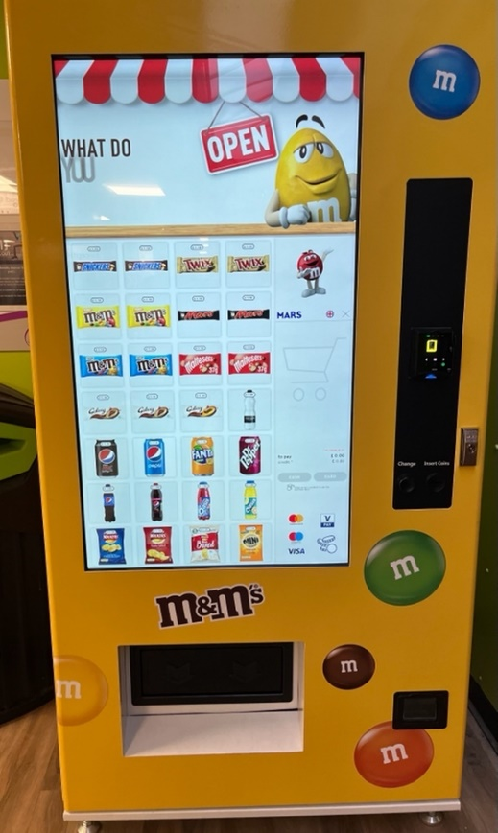
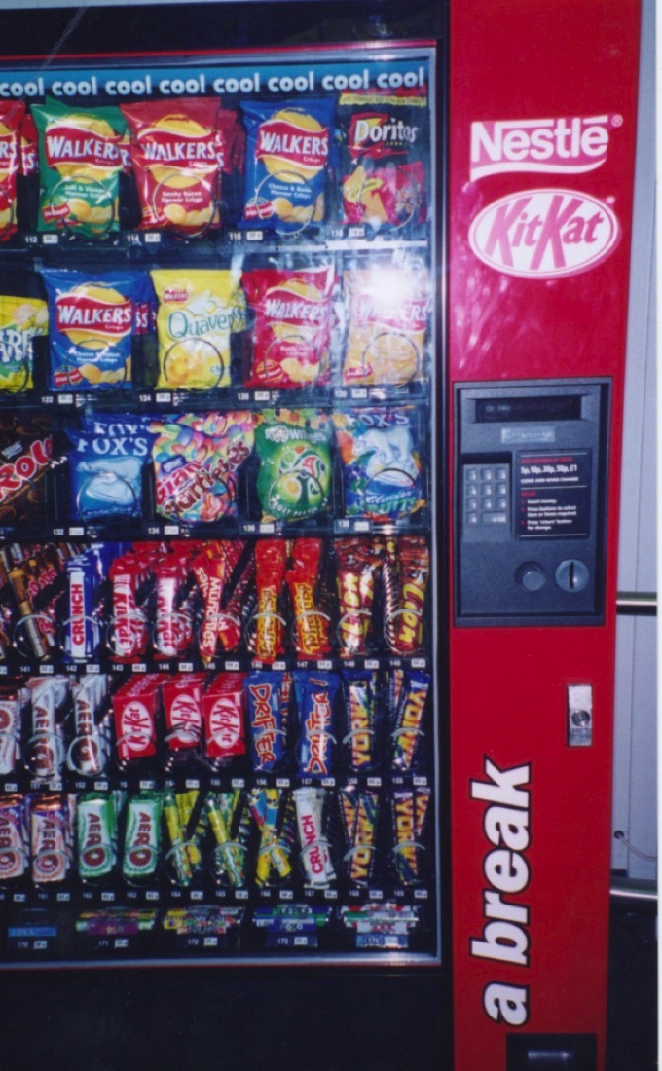
Which is easiest and why?

Slide 36
2. Conversing
Underlying model of having a conversation with another human
Ranges from simple voice recognition menu-driven systems to more complex ‘natural language’ dialogs
Examples include timetables, search engines, advice-giving systems, help systems, virtual agents, chatbots, toys, and pet robots designed to converse with people

Slide 37
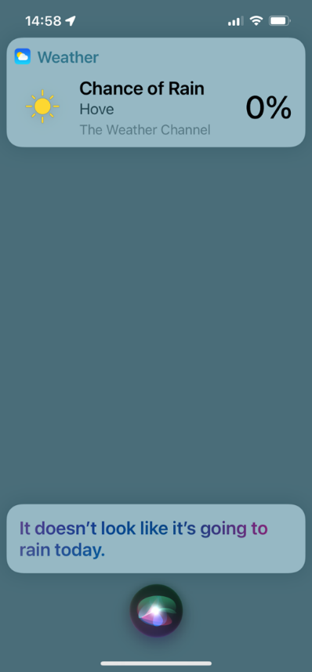
Pros and Cons of Conversational Model
Allows people to interact with a system in a way that is familiar to them
can make them feel comfortable, at ease, and less scared
Misunderstandings can arise when the system does not know how to parse what someone says
e.g, voice assistants can misunderstand what children say
Siri’s response when asked if a person needs an umbrella today

Slide 38
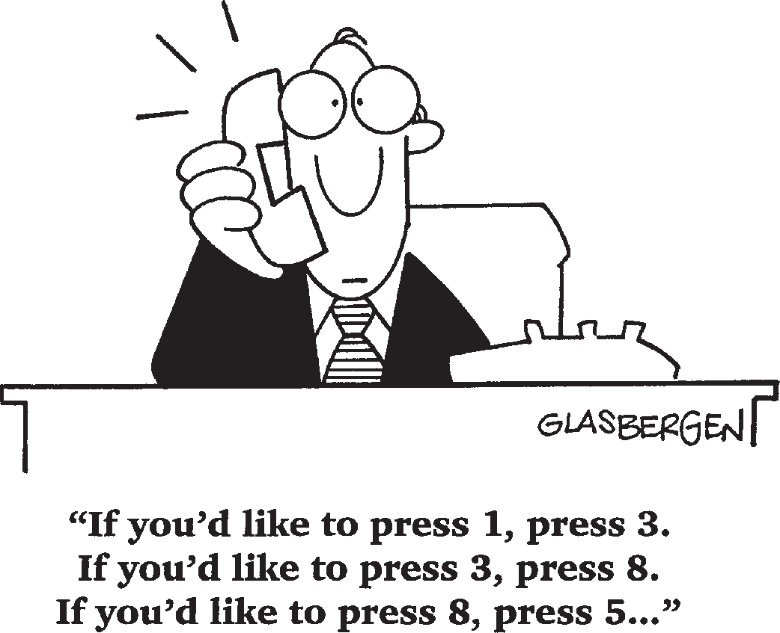
Pros and Cons of Conversational Model

Slide 39
3. Manipulating
Involves dragging, selecting, opening, closing and zooming actions on virtual objects
Exploit’s someone’s knowledge of how they move and manipulate in the physical world
Can involve actions using physical controllers or air gestures to control the movements of an on-screen avatar
Tagged physical objects (for instance, balls) that are manipulated in a physical world result in physical/digital events (such as animation)

Slide 40
Direct Manipulation
Ben Shneiderman (1983) coined the term
Three core properties:
Continuous representation of objects and actions of interest
Physical actions and button pressing instead of issuing commands with complex syntax
Rapid reversible actions with immediate feedback on object of interest

Slide 41
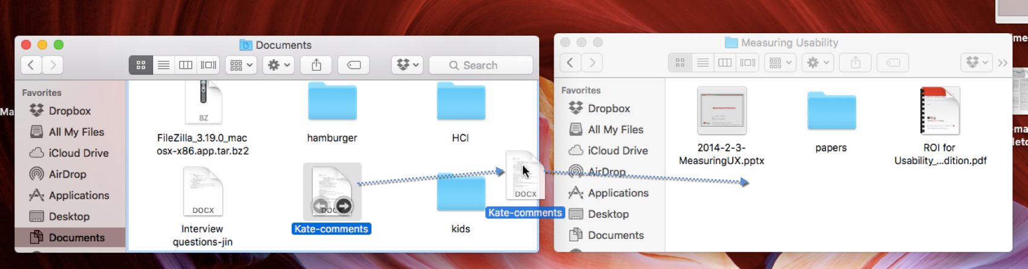
Direct Manipulation
Moving a file on MacOS using direct manipulation involves dragging that file from the source folder and moving it into the destination folder.
Source: https://www.nngroup.com/articles/direct-manipulation/

Slide 42
Benefits of Direct Manipulation
Novices can learn the basic functionality quickly
Experienced users can carry out a wide range of tasks efficiently and rapidly
Intermittent users can retain operational concepts over time
Error messages rarely needed
Users can immediately see if their actions are furthering their goals, and if not, do something else
Users experience less anxiety
Users gain confidence and mastery and feel in control

Slide 43
Disadvantages
Some people take the metaphor of direct manipulation too literally
Not all tasks can be described by objects, and not all actions can be done directly
Some tasks are better achieved through delegating, for example, spell checking
Can become screen space ‘gobblers’
Moving a cursor using a mouse or touchpad can be slower than pressing function keys to do the same actions

Slide 44
4. Exploring
Involves moving through virtual or physical environments
People can explore aspects of a 3D environment
Physical environments can also be embedded with sensors that when detect the presence of someone will trigger digital or physical events to happen
Many examples of virtual environments, including cities, parks, buildings, rooms, and datasets
enable people to fly over them and zoom in and out of different parts

Slide 45
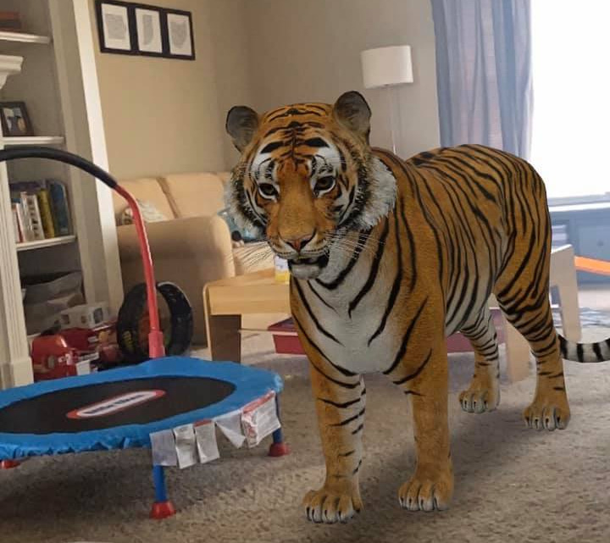
Seeing things larger than life and in situ in AR
A virtual lion appearing in someone’s living room created with Google 3D object
Source: www.cnet.com/tech/services-and-software/google-3d-animals-how-to-use-cool-ar-feature-at-home-list-
of-objects

Slide 46
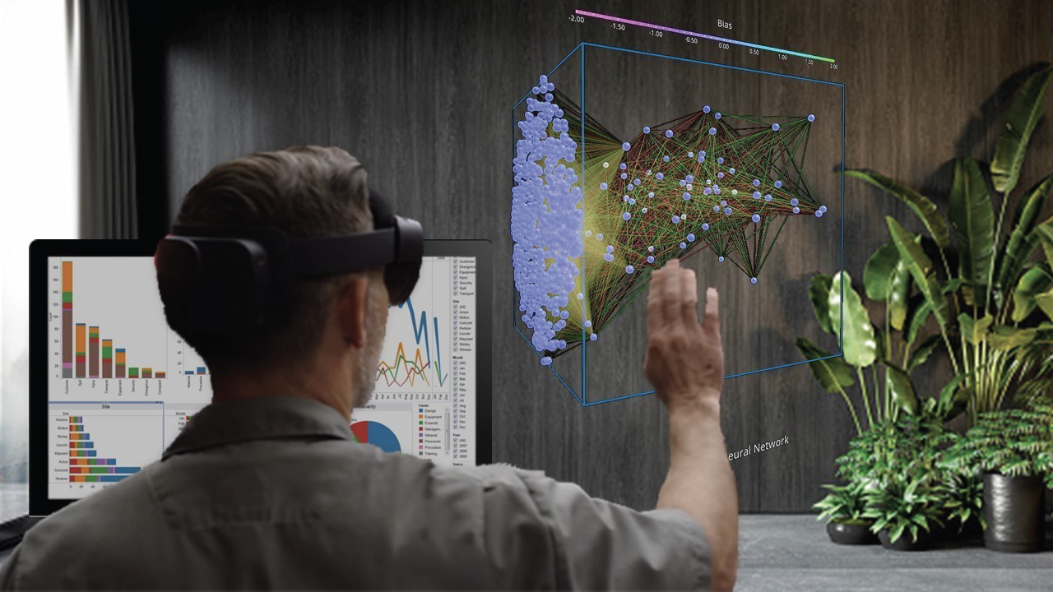
Exploring Data in VR
Someone using Immersive data analytics allowing them to explore Tableau data in 3D

Slide 47
5. Responding
This type suggested by Christopher Lueg et al. (2018)
System takes the initiative to alert user to something that it “thinks” is of interest
System does this by:
detecting the location and-or presence of someone in a vicinity and notifying them on their phone or smartwatch
what it has learned from their repeated behaviors
Examples:
alerts the user of a nearby coffee bar where some friends are meeting
A wearer’s fitness tracker notifies them of a milestone reached
Automatic system response without any requests made by the user

Slide 48
Potentials Cons of System-initiated Notifications
Can get tiresome or frustrating if too many notifications or the system gets it wrong
What does it do when it gets something wrong?
Does it apologise?
Does it allow the user to correct the advice or information?

Slide 49
Choosing an Interaction Type
Direct manipulation is good for ‘doing’ types of tasks, for example, designing, drawing, flying, driving, or sizing windows
Issuing instructions is good for repetitive tasks, for example, spell-checking and file management
Having a conversation is good for finding out information, requesting music/TV or learning
Hybrid conceptual models are good for supporting multiple ways of carrying out the same actions

Slide 50
Difference between Interaction Types and Interface Styles
Interaction type:
A description of what a person is doing when interacting with a system, for example, instructing, talking, browsing, or responding
Interface style:
The kind of interface used to support the interaction, for instance, command, menu-based, gesture, or voice

Slide 51
Many Kinds of Interface Styles Available (More in the next topic)
Command
Speech
Data-entry
Form fill-in
Query
Graphical
Web
Pen
Augmented reality
Gesture

Slide 52
Which Interaction Type to Choose?
Need to determine requirements and user needs
Take budget and other constraints into account
Also will depend on suitability of technology for activity being supported

Slide 53
Watch these videos!
VW’s vision of its future car can be seen in this video: https://www.youtube.com/watch?v=AyihacflLto
See Stanford university’s video on HAI: http://www.youtube.com/watch?v=4W2kXBBFDw4&t=4s
You can watch a video about the Apple Knowledge Navigator here: https://www.youtube.com/watch?v=HGYFEI6uLy0

Slide 54
Activity
Please watch the movie Atlas (available on Netflix or YouTube trailer here: https://www.youtube.com/watch?v=Jokpt_LJpbw).
This film provides an interesting perspective on affective computing, neural link, and how adaptive systems can learn and interact emotionally with humans.
It’s a great example of how future human-computer interaction might evolve beyond conventional interfaces.
Watch it to gain innovative ideas and inspiration for your HCI project or discussions on intelligent and emotional interaction design.

Slide 55
Summary
Developing a conceptual model involves:
Understanding the problem space
Being clear about your assumptions and claims
Specifying how the proposed design will support people in their activities
A conceptual model is a high-level description of a product in terms of:
What users can do with it and the concepts they need to understand how to interact with it
Interaction types provide a way of thinking about how to support user’s activities

